Slide 1
CS 4530: Fundamentals of Software Engineering Module 11: What makes a good test suite?
Jonathan Bell, Adeel Bhutta, Mitch Wand
Khoury College of Computer Sciences
© 2022 Released under the CC BY-SA license

Slide 2
Learning Objectives for this Lesson
By the end of this lesson, you should be able to:
Explain what makes a good test, and give examples and counter examples
Explain different things a test suite might accomplish, and sketch how one might judge how well a test suite accomplishes those goals
Notes:
We use testing to evaluate our software systems. This is captured in famous V&V terminology: Validation: Are we building the right product?
Verification: Are we building the product right?
Now, how do we evaluate testing itself? We will have to study two things: Purpose: Are tests checking the right things?
Adequacy: Are they checking the things right?

Slide 3
What makes for a good test (suite)?
Desirable properties of test suites:
Find bugs
Run automatically
Are relatively cheap to run
Desirable properties of individual tests:
Understandable and debuggable
No false alarms (not “flaky”)
Related Terminology: “test smells”
Notes:
<read slide>
Discuss: Are there any other qualities for a “good” test?

Slide 4
Good Tests are Hermetic
Contain all information necessary to set up, execute, and tear down environment
Leaves no trace of its execution
Important to reduce flakiness - test failures
describe('Create student', () => {
it('should return an ID', async () => {
const createdStudent = await client.addStudent('Avery');
expect(createdStudent.studentID).toBeGreaterThan(4);
});
})
This test is not hermetic: assumes starting ID of 4, leaves an extra Avery in the application
“Software Engineering at Google: Lessons Learned from Programming Over Time,” Wright, Winters and Manshreck, 2020 (O’Reilly)
Notes:
<read slide>

Slide 5
Good Tests Aren’t Flaky
Flaky test failures are false alarms
Tests that are hermetic defend against “test order dependency” - failures due to tests running in specific order
Most common cause of flaky test failures: “async wait” - tests that expect some asynchronous action to occur within a timeout
Good tests avoid relying on timing
[Luo et al, FSE 2014 “An empirical analysis of flaky tests”]
Notes:
<read slide>

Slide 6
Good Tests Aren’t Brittle
Brittle tests make invalid assumptions about the specification
Specifications often leave room for undefined behaviors: details that are subject to change
Brittle tests will fail unexpectedly if that undefined behavior changes
Example: Asserting that a specific error message is thrown (IP1)
it('Throws an error if there is no layer called "objects"', async () => {
expect(() => town.initializeFromMap(testingMaps.noObjects))
.toThrowError('There is no layer called "objects"');
});
Unless the specification states that this is the error message that should be thrown, this test is brittle
Notes:
<read slide>

Slide 7
Good Tests are Clear
Test failures indicate:
There is a bug in the system under test, and/or
There is a bug in the test
Clear tests help engineers diagnose the actual problem
it(‘remove only removes one’, () =>{
const tree = makeBST();
for (let i = 0; i < 1000; ++i) {
tree.add(i);
}
for (let j = 0; j < 1000; ++j) {
for (let i = 0; i < 1000; ++i) {
if (i != j) tree.remove(i);
}
expect(tree.contains(j)).
toBe(true);
}
}
This test is not clear: if it fails, why?
“Software Engineering at Google: Lessons Learned from Programming Over Time,” Wright, Winters and Manshreck, 2020 (O’Reilly)
Notes:
Problem: Test is hard to understand; Testing too much code in one test; If it fails, no clue as to what went wrong: “false is not true”; Test code has conditionals/loops
(Incidentally, also suffers from hard-coding 1000 in the test.)

Slide 8
Good Tests Invoke Public APIs Only
Tests should only invoke public methods of SUT (system under test)
Interact with SUT as a client of the SUT would:
Public methods within classes
Exported members of modules
public initializeFromMap(map: ITiledMap) {
...
this._validateInteractables();
}
private _validateInteractables() {
// Test Me!
}
It might be tempting to make _validateInteractables public and test it directly: but it’s not how clients would call it!
“Software Engineering at Google: Lessons Learned from Programming Over Time,” Wright, Winters and Manshreck, 2020 (O’Reilly)
Notes:
<read slide>
Discuss: Are there any other qualities for a “good” test?

Slide 9
What makes a Test Suite good?
Depends on the goal of the test suite.
Test Driven Development
Does the SUT satisfy its specification? (“functional testing”)
“Good” test suite exercises and validates the entire specification
Regression Test
Did something change since some previous version?
Prevent bugs from (re-)entering during maintenance.
“Good” test suite detects bugs that we introduce in code (“structural testing”)
Acceptance Test
Does the SUT satisfy the customer (“requirement testing”)
“Good” test suite answers: Are we building the right system ?
Notes:
<read slide>

Slide 10
Does the SUT satisfy its specification?
Test behavior without regard to the implementation (“black-box testing” or “functional testing”).
What’s a specification?:
A precise definition of all acceptable behaviors of a SUT (outputs, state mutation, other effects) in all situations (state and inputs)
A specification may be formal (mathematical), informal (natural language) or implicit (“I know it when I see it”).
A test suite is an approximation to an unwritten specification
That’s the “T” in TDD
Adequacy of test suite is likelihood that an implementation passing all the tests actually fulfills the (unwritten) specification.
Not often seen in the wild
Notes:
<read slide>

Slide 11
Building Test Suites From Specifications (TDD)
Enumerate equivalence classes of inputs to the SUT, and the expected behavior of that class
Identify boundary cases (near misses between input classes)
Evaluate the adequacy of the test suite by comparing the tested behaviors with the specified behaviors
Sometimes referred to as “black box” testing
A
B
If the program works for input A, it will probably work for input B
Notes:
So how do we choose equivalence classes? The key is to identify input conditions from the spec. Each input condition induces an equivalence class – valid and invalid inputs.
For example, an input condition that specifies a range of values induces three equivalence classes: one containing values smaller than the lower bound of the range, one with values within the range, and one containing values larger than the upper bound of the range
Similarly, an input condition that specifies a specific value, …
Likewise, set membership and conditions that correspond to boolean predicates can be represented using two equivalence classes

Slide 12

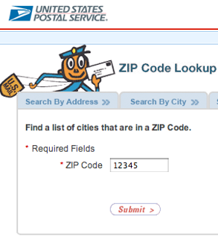
Building Test Suites From Specifications: Zip Code Lookup
USPS ZIP code lookup tool accepts a zip code as input, and outputs:
The “place names” that correspond to that ZIP code, or
“Invalid zip code”
Strategy:
Determine the input equivalence classes, boundary conditions
Write tests for those inputs

Slide 13
Building Test Suites From Specifications: Zip Code Lookup
USPS ZIP code lookup tool accepts a zip code as input, and outputs:
The “place names” that correspond to that ZIP code, or
“Invalid zip code”
All possible inputs
All 5 digit numbers
Valid ZIP codes
ZIP codes with multiple place names
Notes:
(Point out to students: if you are not aware, there is a one-to-many relationship from zip codes to place names. A place name might be a city, or another name that the USPS historically accepts in place of a city. Ask students if they know of any examples. One is: 02120 -> Roxbury Crossing OR Boston OR Mission Hill OR Roxbury OR Roxbury Xing. Not all 5 digit numbers are valid zip codes, some are reserved for future use)

Slide 14
Building Test Suites From Specifications: Zip Code Lookup
Equivalence classes:
Not a 5 digit number
A 5 digit numbers
A valid ZIP code
With one place name
With multiple place names
Not a valid ZIP code
Generate at least one input from each class, plus boundaries (e.g. 4 digit numbers, 6 digit numbers, no numbers)
Encode the expected output of the system for each test
All possible inputs
All 5 digit numbers
Valid ZIP codes
ZIP codes with multiple place names

Slide 15

Make sure the regions have the right boundaries.
Select “special” values of a range
Boundary values;
Barely legal, barely illegal inputs;
=> boundary testing
Integer overflow a serious problem: may be implicit
ComAir problem due to a list getting more than 32767 elems
https://arstechnica.com/uncategorized/2004/12/4490-2/
Notes:
Typically, a greater number of errors occurs at the boundaries of an equivalence class rather than at the “center”.
Therefore, we specifically look for values that are at the boundaries.
In the example you see here, we could select a value just outside of the lower end of the range, just inside the lower end of the range, …
If your system has well-defined inputs and outputs, you can apply this technique both to the input domain and the output domain.

Slide 16
Building Tests from Specifications (TDD)
When delivering a feature, it is important to deliver tests to ensure that the feature keeps working this way in the future
You may have specific domain knowledge that future developers who touch the code do not
Specifications are hard to interpret and check, automated tests are easy (consider individual project…)
Beyoncé rule: “If you liked it you should have put a ring test on it” (SoftEng @ Google)
All possible inputs
All 5 digit numbers
Valid ZIP codes
ZIP codes with multiple place names
Notes:
(Read slide - this should follow from the discussion of zip codes with multiple place names that it would be important to encode this behavior in a test to ensure that a future dev doesn’t assume that zip codes have at most one place name)

Slide 17
Building Test Suites for Code (“Whitebox” Testing)
Examine the code of the system under test
Enumerate all public methods and observable behaviors
Write tests that execute those methods and check those behaviors
A “good” test suite executes and checks all of the possible behaviors of our code
function getPlaceNames(input: string): string[] {
try{
if(input.length == 5) {
const parsed = parseInt(input);
if (isValidZipcode(parsed)) {
const primaryPlaceName = getPrimaryPlaceName(parsed);
if(hasOtherPlaceNames(parsed)){
return [primaryPlaceName].concat(otherPlaceNames(parsed))
}
return [primaryPlaceName];
}
}
throw new Error("Invalid zip code")
}catch(err){
throw new Error("Invalid zip code")
}
}
Notes:
Another way to generate tests is to consider not just the overall specification, but the actual code that we are testing.
(Read slide)
The code snippet on the right might represent the implementation of the USPS zip code lookup. With the code at hand, we can begin to enumerate inputs that will cover the different behaviors.

Slide 18
Do our tests execute all of the code?
Idea: Quantitative measure the portion of code executed by test suite. Write new test inputs to execute more code.
This is the question of test coverage, examples:
Statement or Block coverage
Branch coverage
Path coverage
If some (statement/branch/path) is not covered, it is definitely not tested
If some (statement/branch path) is covered, it might be tested
Notes:
When you talk about code coverage, there are a lot of different kinds of coverages that we often talk about. The list is long but here are few important ones.
<read slide>

Slide 19
Statement Coverage
Each line (or part of) the code should be executed at least once in the test suite
There are good tools for measuring how many lines were executed or not executed
Jest -- coverage
Adequacy criterion: each statement must be executed at least once
Coverage: # executed statements # statements
Notes:
Statement coverage criterion states that each statement (or CFG node) should be covered.
The rationale for this criterion is that a defect in a given statement can only be discovered if that statement is executed
You can express statement coverage as a percentage: <…>

Slide 20
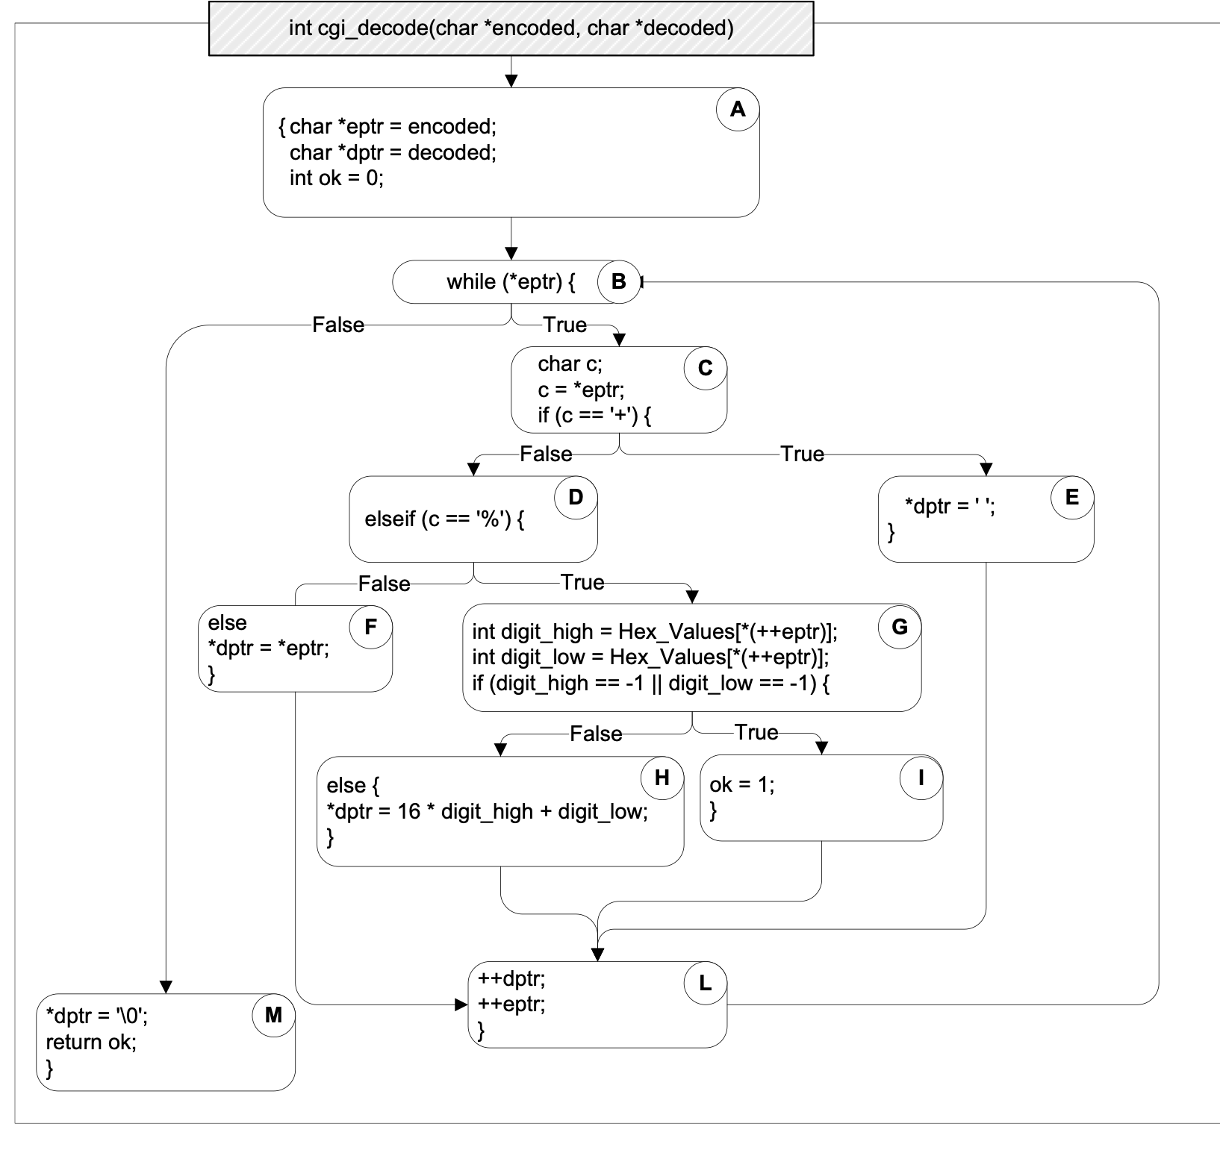

“test”
A
✔
B
✔
C
✔
D
E
✔
F
G
✔
H
I
L
✔
M
✔
Notes:
Let’s apply this to the cgi_decode example. Here block is code is highlighted in a rectangle (or a node in a tree) and then paths are liked edges of the tree
The initial coverage is 7/11 blocks = 63%.
(We could also count the statements instead (here: 14/20 = 70%), but conceptually, this makes no difference)

Slide 21
“test”
A
“a+b”
✔
B
✔
C
✔
D
E
✔
✔
F
G
✔
H
I
L
✔
M
✔
Notes:
and the coverage increases with each additionally executed statement…
if we add the second test, coverage increases to 72%

Slide 22
“test”
A
“a+b”
✔
“%3d”
B
✔
C
✔
D
E
✔
✔
F
G
✔
✔
H
I
✔
L
✔
M
✔
Notes:
Adding the third test increases coverage to 91%

Slide 23
“test”
A
“a+b”
✔
“%3d”
“%g”
B
✔
C
✔
D
E
✔
✔
F
G
✔
✔
H
I
✔
✔
L
✔
✔
M
✔
Notes:
And with adding the last test, we reach 100% block coverage (which is 100% statement coverage, too).

Slide 24
Branch Coverage
Adequacy criterion: each branch in the CFG must be executed at least once
coverage: # executed branches # branches
Subsumes statement testing criterion because traversing all edges implies traversing all nodes
Most widely used criterion in industry
Notes:
Another testing criterion is the branch testing criterion, which states that each branch in the CFG should be executed at least once.
We say that the branch testing criterion subsumes the statement testing criterion
…because if a test suite satisfies the branch testing criterion for a given program, then it also satisfies the statement testing criterion for that program

Slide 25

Branch Coverage Measures
Coverage is computed automatically while the tests execute
jest --coverage
Does it all for you
*see example at https://github.com/philipbeel/example-typescript-nyc-mocha-coverage
Notes:
Many forms of coverage can be computed automatically using automated tools
This is typically done by instrumenting the program so that whenever a statement/block is executed, a corresponding counter is updated.
For JS/TS, the Instanbul/NYC tool can be used to compute coverage

Slide 26
Every Branch Executed != Every Behavior Executed
In this example, all branches are covered by the test
However: magic will crash under certain inputs
function magic(x: number, y: number) {
let z = 0;
if (x !== 0) {
z = x + 10;
} else {
z = 0;
}
if (y > 0) {
return y / z;
} else {
return x;
}
}
test(“100% branch coverage", () => {
expect(magic(1, 22)).toBe(2); //T1
expect(magic(0, -10)).toBe(0); //T2
});
✅ T1
✅ T2
✅ T1
✅ T2
Notes:
(Read bullets, then click one-by-one to show all 4 branches covered. The bug is if y > 0 and x == 0)
A strong criteria would be “path” coverage, which would say that in this case, we need to execute all combinations of the branches.

Slide 27
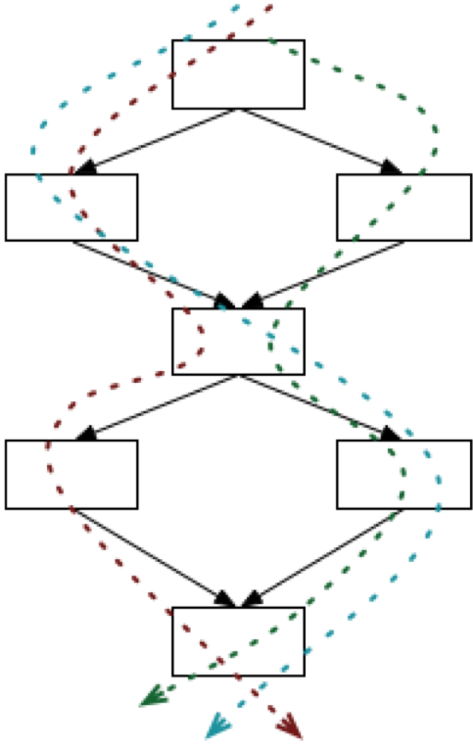
Path Coverage is Exhaustive
Sometimes a fault is only manifest on a particular path
E.g., choosing the left branch and then choosing the right branch. (dashed blue path)
But the number of paths can be infinite
E.g., if there is a loop.
There are ways to bound the number of paths to cover.
Notes:
The next testing criterion we consider is path testing.
This criterion is not practical because, in the presence of loops, the number of paths may be infinite
Discuss: How do you path independent paths of the graph?
Cyclomatic Complexity can be used to limit the number of paths to cover. It measures the number of linearly-independent paths.
Discuss: How would you test the code with loops in it?
We typically test by running the loops, 0, 1, 2, n-1, n and n+1 times.

Slide 28
100% Coverage may be Impossible
Path coverage (even without loops)
Dependent conditions: if (x) A; B; if (x) C;
Branch coverage
Dead Branches e.g., if (x < 0) A; else if (x == 0) B; else if (x > 0) C;
(x > 0) test will always succeed
Statement coverage
Dead code (e.g., defensive programming)
Notes:
<read slide>

Slide 29

Pareto’s Law
Approximately 80% of defects come from 20% of modules
Notes:
The diagram relates to a principle coined by the Italian economist Vilfredo Pareto in the year 1896 that says “roughly 80% of consequences come from 20% of the causes”
In the scenario of software engineering, Pareto’s Law can be interpreted to say that approximately 80% of defects originates from 20% of modules

Slide 30
Good Tests have Strong Oracles
Test oracle defines criteria for when test should fail
Strong oracles check all observable behaviors and side-effects
How to determine an oracle?
Function returns the exact “right” answer
Function returns an acceptable answer
Returns the same value as last time
Function returns without crashing
Function crashes (as expected)
Notes:
Even if we have 100% path coverage, we may not actually have effective tests, because these coverage criteria only reflect the code that is executed, and not what is checked. “What is checked” is our assertions/expectations.
Generally speaking, we call the part of the test that checks for the correct behavior the “oracle”. (Read slide)
Examples of oracles:
Knows the “right” answer: a function that computes 2 + 2 should return 4 – this is something that we can precisely capture, entirely, that we are checking that the answer is “exactly” right. No side-effects, just a function that returns the sum of two integers.
Acceptable answer: A probabilistic function should be correct N% of the time, or: some part of the output is correct (but unsure about others)
Same value as last time: just regression tests. Don’t know if the last time was right, but we see the same thing
Sometimes crashing is expected, like if you are testing that something should throw an exception!

Slide 31
How to evaluate the strength of test oracles?
Goal: “A good test suite finds all of the bugs”
Problem: How to know the bugs that we could make?
Strawman - “Seeded Faults”:
Create N variations of the codebase, each with a single manually-written defect
Evaluate the number of defects detected by test suite
Test suite is “good” if it finds all of the bugs you can think of
Notes:
(Read slide, then discuss)
Note that the strawman is probably something that we should do for particular faults that we really want to make sure we are testing for, and it is a good strategy to have in your back pocket. But, there are definitely problems with applying this at scale…
Do we write realistic bugs?
Do we inject all of the possible bugs?
Time intensive to inject bugs
This approach has been commonly used for grading student test suites.

Slide 32
Mutation Analysis Tests the Tests
Idea: What if many (real) bugs could be represented by a single, one-line “mutation” to the program?
public contains(location: PlayerLocation): boolean {
return (
location.x + PLAYER_SPRITE_WIDTH / 2 > this._x &&
location.x - PLAYER_SPRITE_WIDTH / 2 < this._x + this._width &&
location.y + PLAYER_SPRITE_HEIGHT / 2 > this._y &&
location.y - PLAYER_SPRITE_HEIGHT / 2 < this._y + this._height
);
}
Correct code for ‘Contains” in IP1
public contains(location: PlayerLocation): boolean {
return (
location.x + PLAYER_SPRITE_WIDTH / 2 < this._x &&
location.x - PLAYER_SPRITE_WIDTH / 2 < this._x + this._width &&
location.y + PLAYER_SPRITE_HEIGHT / 2 > this._y &&
location.y - PLAYER_SPRITE_HEIGHT / 2 < this._y + this._height
);
}
Mutated (and buggy) code for ‘Contains” in IP1
Notes:
Mutation analysis is an automated approach to evaluate how good tests are at detecting bugs.
The key idea is to create “mutations” - variants of the code that are likely to be buggy. Then, we could determine whether our test suite detects these “mutants” as a proxy for detecting bugs that we might make.

Slide 33
Mutation Analysis Tests the Tests
Automatically mutates SUT to create mutants, each a single change to the code
Runs each test on each mutant, until finding that a mutant is detected by a test
Can be a time-consuming process to run, but fully automated
State-of-the-art mutation analysis tools:
Pit (JVM)
Stryker (JS/TS, C#, Scala)
Notes:
(We will use stryker in today’s activity)

Slide 34
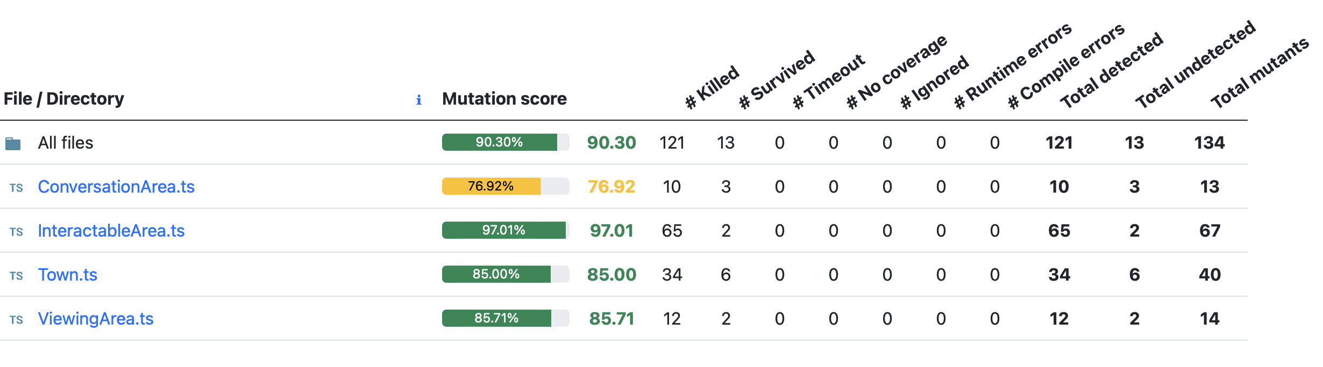
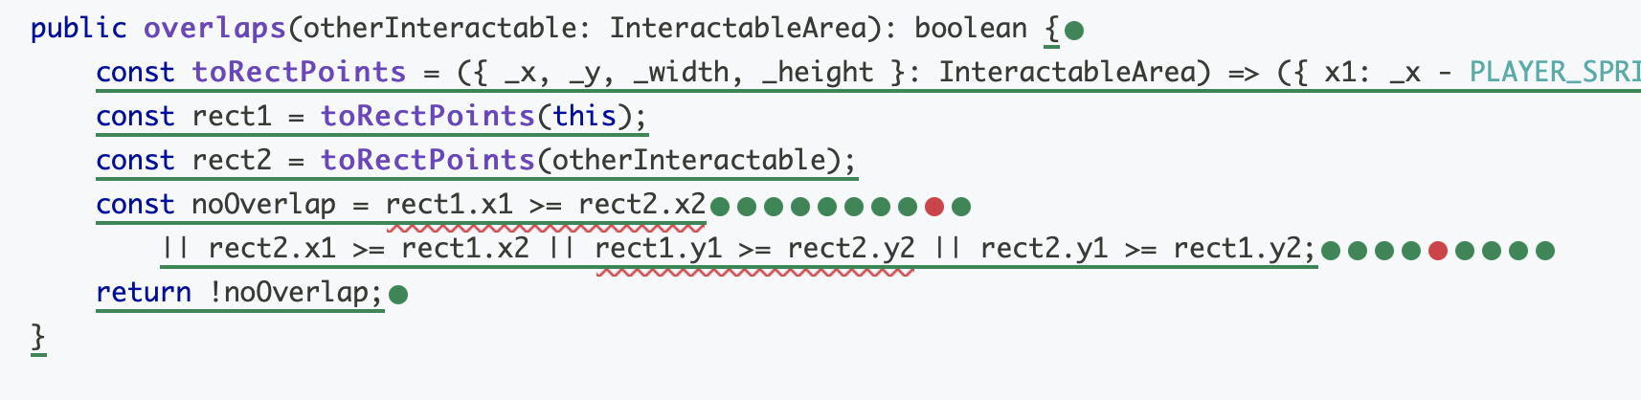
Mutation Report Shows Undetected Mutants
Mutants “detected” are bugs that are found
Mutants “undetected” might be bugs, or could be equivalent to original program (requires a human to tell)

Slide 35
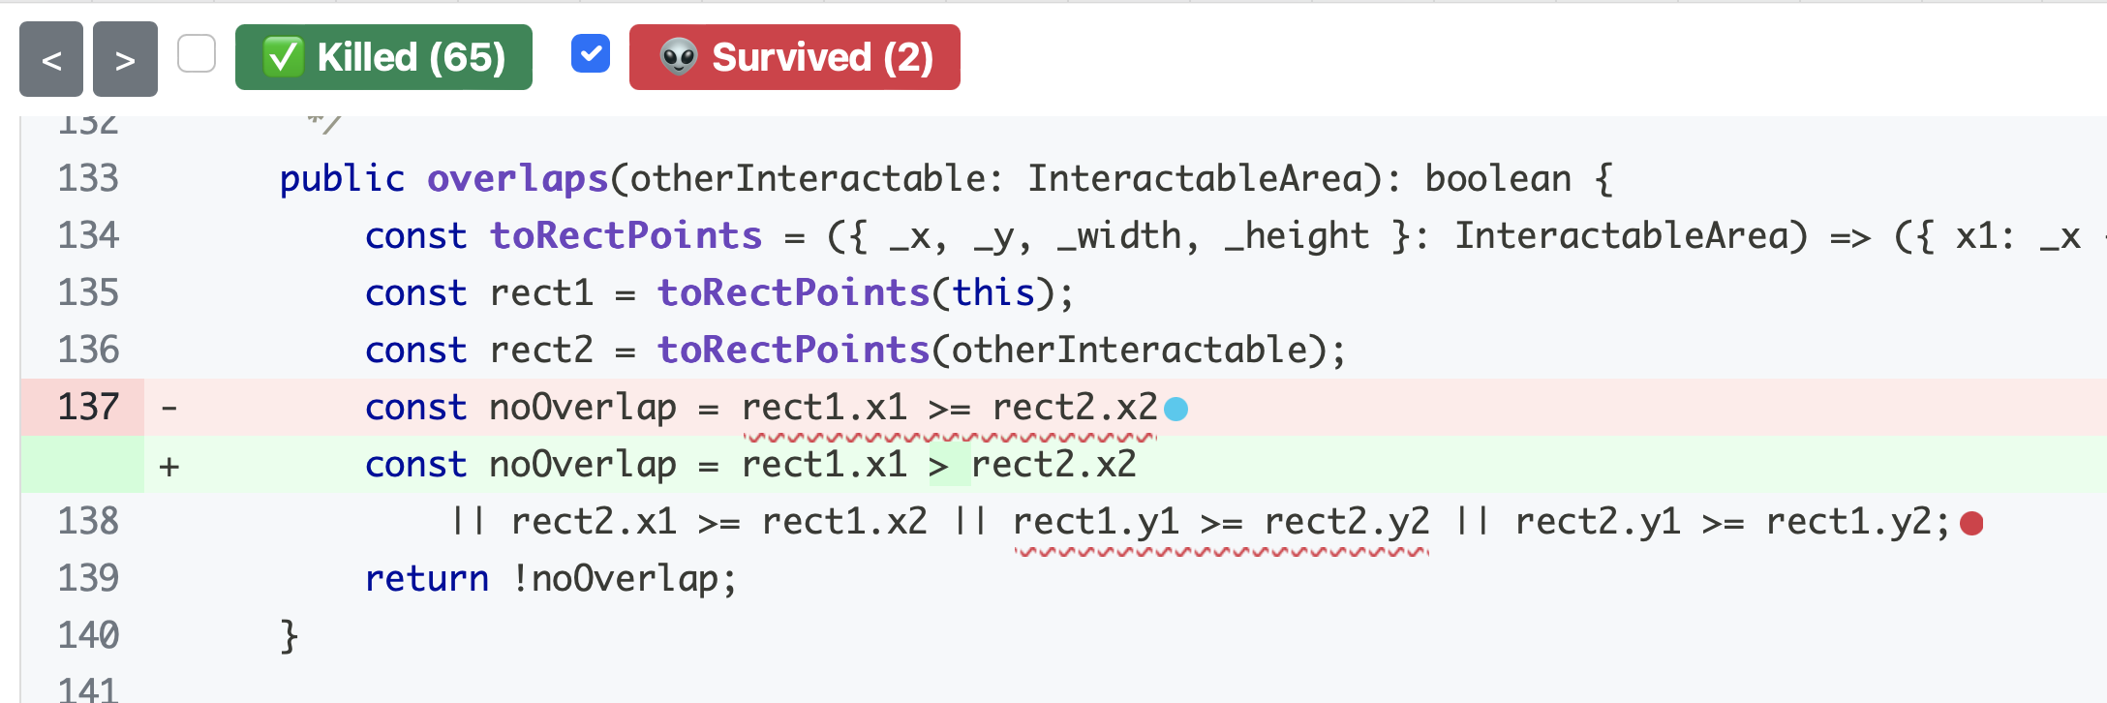
Use Mutation Analysis While Writing Tests
When you feel “done” writing tests, run a mutation analysis
Inspect undetected mutants, and try to strengthen tests to detect those mutants
Detailed mutation report for “overlaps” method - two mutants were not detected!
Notes:
Mutation analysis helps us improve our tests as we write them, because it shows us changes to our code (potential bugs!) that our tests do not detect. Remember, that to “detect” a mutant means that at least one test in your test suite fails when run on the mutated code.
This screenshot shows a mutation report from the tool Stryker, when run on our overlaps method. Stryker uses the terms “survived” to mean “not detected” and “killed” to mean “detected”. In this screenshot, we can see two undetected mutants, one that is expanded on line 137. The red line shows how the line was before the mutation, and the green line shows the line after the mutation. In this case, the mutation was to replace a >= with a > sign. There is also an undetected mutation on line 138, but it is not expanded (the red dot). When working through the report, you see them a single mutant at a time (because that’s what was run – one mutant at a time).

Slide 36
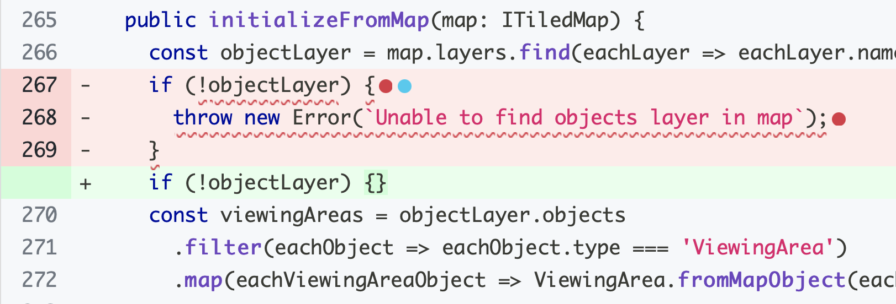
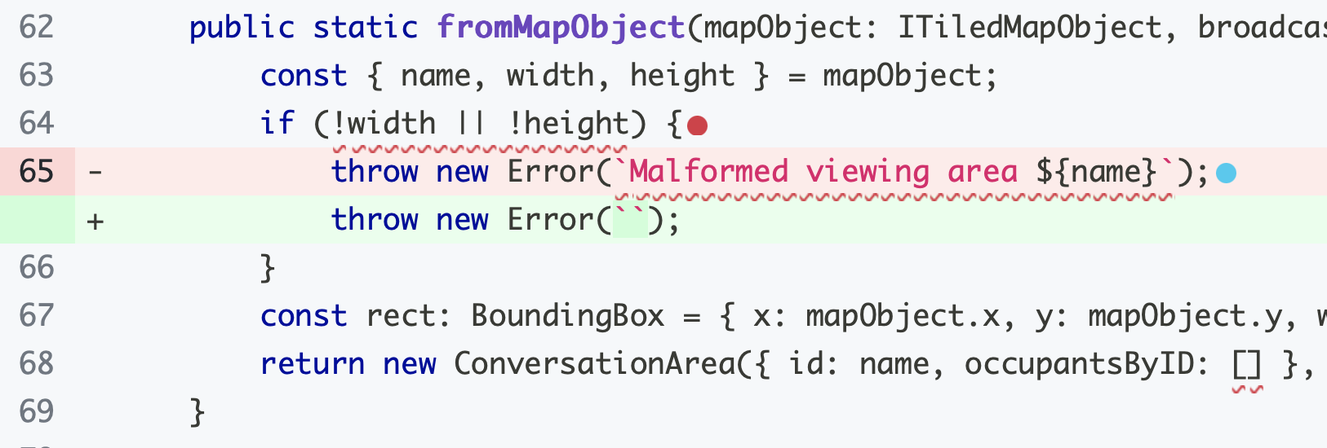
Undetected Mutants May Not Be Bugs
Unfortunately, we can not automatically tell if an undetected mutant is a bug or not
This mutant is equivalent to the original program: Even without this check for undefined, an error is still thrown when the undefined layer is dereferenced on the following line
This mutant is equivalent to the original program: Even though the error message changed, the specification doesn’t indicate what error message should be thrown.
Notes:
We can not ever aim to achieve 100% mutation coverage (detect all of the mutants) because it is likely that not all mutants are bugs. These mutants are called “equivalent mutants”, and there is no automated way to detect them: you have to examine them by hand. The mutant on the left shows that no test detected the removal of the if (!objectlayer) check. Tests that check to see that this method would throw an exception if objectLayer were undefined will still pass, because the method will still throw an error when referencing the property “objects” on that property.
The one on the right is also equivalent to the original program under the specified semantics, because the specification does not indicate the error message that should be thrown.
(There should probably be better examples here that truly don’t matter since the one on the left would be detectable if there were allowed to be a test on the exception description, but that’s for next time…)

Slide 37

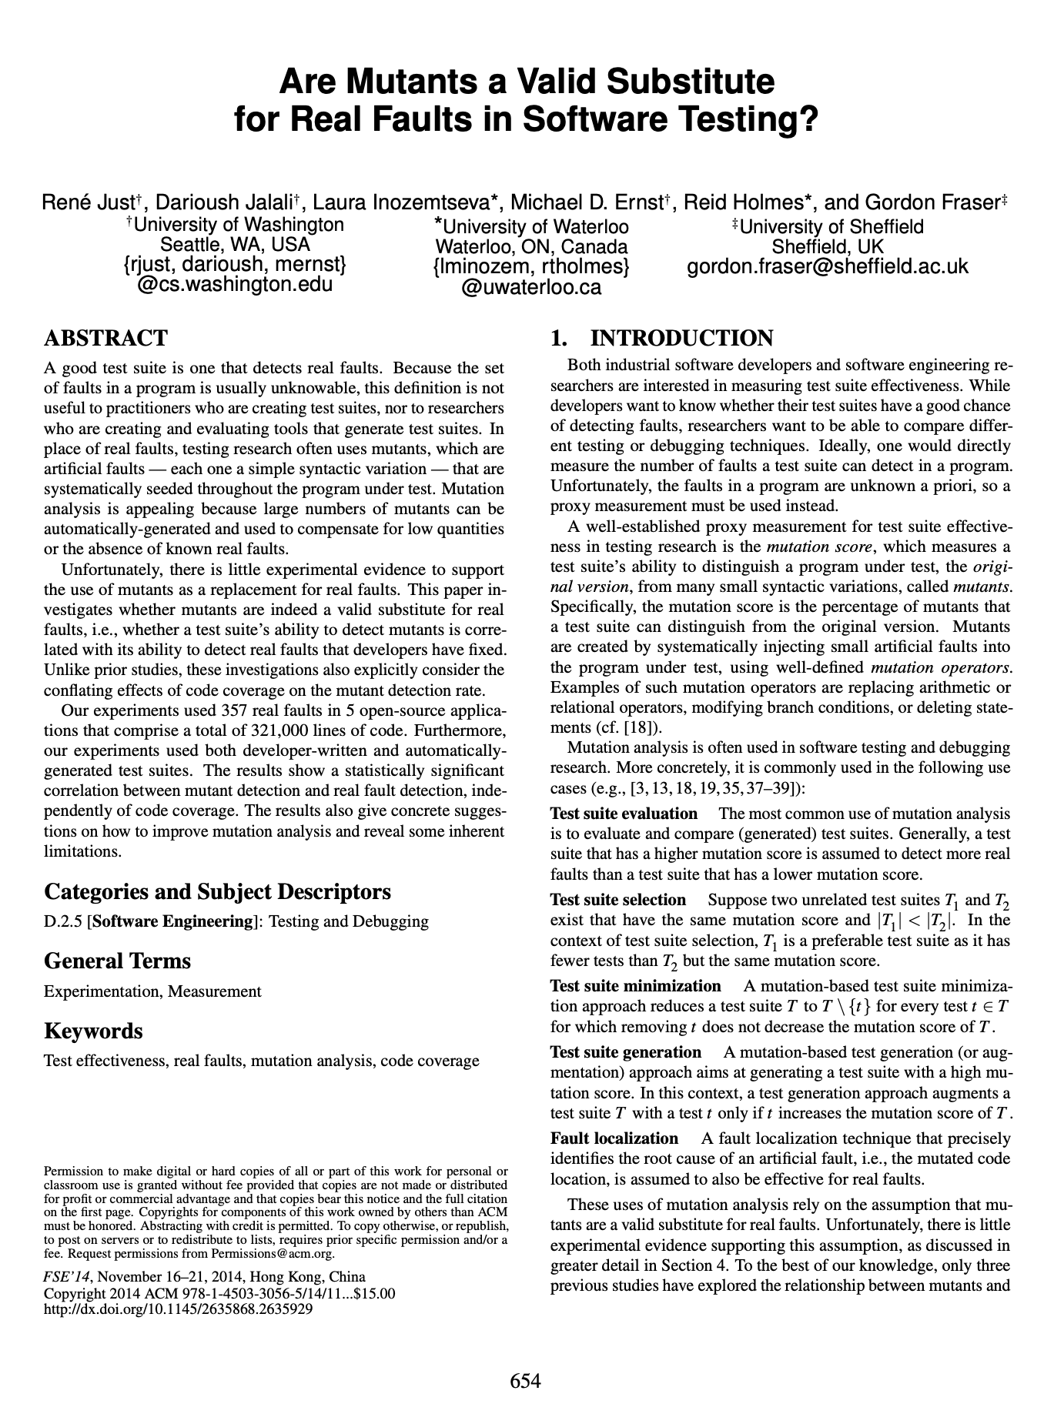
Mutants are a Valid Substitute for Real Faults
Do mutants really represent real bugs?
Researchers have studied the question of whether a test suite that finds more mutants also finds more real faults
Conclusion: For the 357 real faults studied, yes
This work has been replicated in many other contexts, including with real faults from student code
Notes:
You might look at these mutants, which are caused by such simple operations, and wonder: but do these one-line mutations really represent the kinds of bugs that occur in real software? Because ultimately, that is what we are looking to evaluate, right? Do our tests find real bugs.
This study (and others that have replicated it) is important because it shows that this process of enhancing a test suite to detect more mutants might be worth the effort, because there is empirical evidence that: given two test suites, where one detects more mutants than the other (on the same SUT), the one that detects more mutants also finds more real bugs.

Slide 38
Activity: strengthening a test suite
Enhance the test suite of the transcript server to improve line coverage and mutation coverage
Download on Module 11 webpage

Slide 39
Review
Now that you've studied this lesson, you should be able to:
Explain some properties of good tests.
Explain different things a test suite might accomplish, and sketch how one might judge how well a test suite accomplishes those goals

